Slide 1
Unit-2 Network Security and Forensics
Dr. Vijeta Khare

Slide 2
Penetration Testing or Pen Test
Penetration Testing (Pen Testing) is an authorized security assessment that simulates real-world cyberattacks to identify and validate vulnerabilities in systems, networks, or applications.

Slide 3
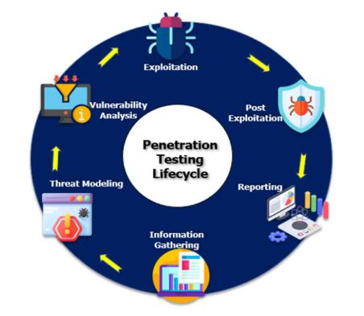
Penetration Testing Life Cycle- Phases
1. Planning & Scoping
Define objectives, scope, timeline, and rules of engagement
Decide testing type: Black Box, White Box, Grey Box
Obtain written legal authorization Tools/Artifacts: Scope document, SOW, approval emails
2. Reconnaissance (Information Gathering)
Collect target information to understand the attack surface
Passive: Google dorking, WHOIS, social media
Active: DNS queries, ping sweeps
Tools: WHOIS, Maltego, theHarvester

Slide 4
3. Scanning & Enumeration
Identify live hosts, open ports, services, and OS
Enumeration extracts detailed system information
Tools: Nmap, Masscan
4. Vulnerability Analysis
Identify known vulnerabilities
Map services to CVE (Common Vulnerabilities and Exposures)band assess risk using CVSS (Common Vulnerability Scoring System)
Tools: Nessus, OpenVAS
5. Exploitation
Exploit vulnerabilities to gain access
Perform privilege escalation if possible
Tools: Metasploit, SQLmap, Burp Suite

Slide 5
6. Post-Exploitation
Assess impact of compromise
Data access, lateral movement, persistence testing
Examples: Credential dumping, pivoting Goal: Impact assessment, not system damage
7. Reporting
Document vulnerabilities, evidence, impact, and remediation
Include Executive Summary and Technical Report
8. Cleanup & Retesting
Remove test artifacts and restore systems
Retest to verify fixes
Also called: Validation testing

Slide 6
Network Scanning with Nmap

Slide 7
Introduction
The first step is Information Gathering in Penetration Testing
Discover the services which are open or closed
Version label
Operation System and its types

Slide 8
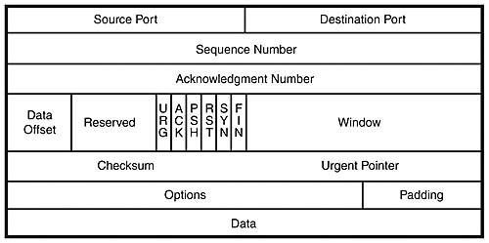
Pre Study
SIZE OF HEADER
20-60 BYTE
SOURCE PORT 16
0-65535
0-1023 WELL KNOWN PORTS
RANDOM 60001
DESTINATION 80
TCP
CONVERT BITS INTO BYTES
SEGMENT
1 1003 1 1002 1 1001
ACK NUM
1 1006 1 1005 1 1004
TCP Packet Header

Slide 9
Cont..
Source and Destination Ports
Sequence Number and Acknowledgment Number
Data Offset ,Reserve , Control flag, Window
Checksum, Urgent Pointer
Options, Padding
Data

Slide 10
TCP Flag Definitions
Flag
SYN | The beginning of a connection
ACK | Acknowledge receipt of a previous packet or transmission
FIN | Close a TCP connection
RST | Abort a TCP connection

Slide 11
TCP conversation
Connect
Disconnect
Client
Server
Client
Server
SYN
FIN
SYN/ACK
ACK/FIN
ACK
ACK
Connection Established
Connection
Closed
Three-way handshake

Slide 12
What is nmap?
NMAP is a free and open source utility for network discovery and security auditing. Like there are too many devices connected to the network and a pentester or network administrators will gather a information like which type of devices, their services uptimes, live systems, which kind of services are running their with the help of this utility.
ZENMAP :-GUI

Slide 13
Quick Start Cheat-sheet
Switch Description Example
-sS TCP SYN port scan. nmap -sS 192.168.1.1
-sT TCP Connect port scan nmap -sT 192.168.1.1
-sU UDP port scan. nmap -sU 192.168.1.1
-sA TCP ACK port scan. nmap -sA 192.168.1.1

Slide 14
Conti......
Switch Description Example
-Pn Only port scan. nmap -Pn 192.168.1.1
-sn Only host discovery. nmap -sn 192.168.1.1
-PR ARP discovery nmap -PR 192.168.1.1
-n Disable DNS resolution. nmap -n 192.168.1.1

Slide 15
HOST Scan
This Scan is used to find or identify active host in the network by sending ARP request packets to all system in that network. And in result it will show a message “Host is up” by Receiving MAC address from Each active host.
Syntax: - nmap -sP target_ip_range
nmap -sn target_ip_range

Slide 16
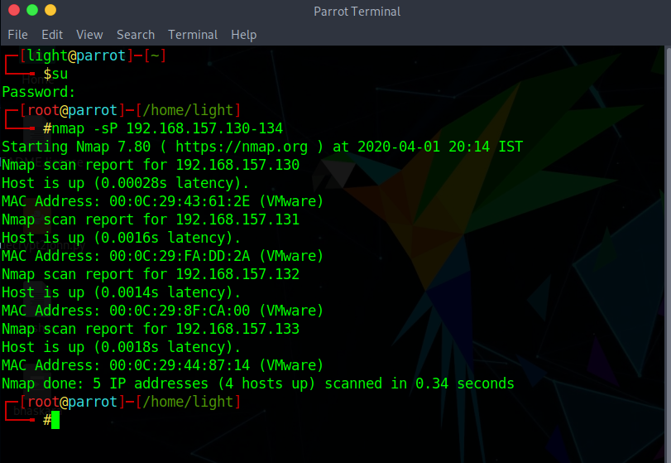

Slide 17
Port Scan/TCP Scan/Stealth Scan
With the help of this scan, User can Identify open or close state of a particular port on target machine.
Six Types of Port status
Open
Closed
Filtered
Unfiltered
Open/Filtered
Closed/Filtered

Slide 18
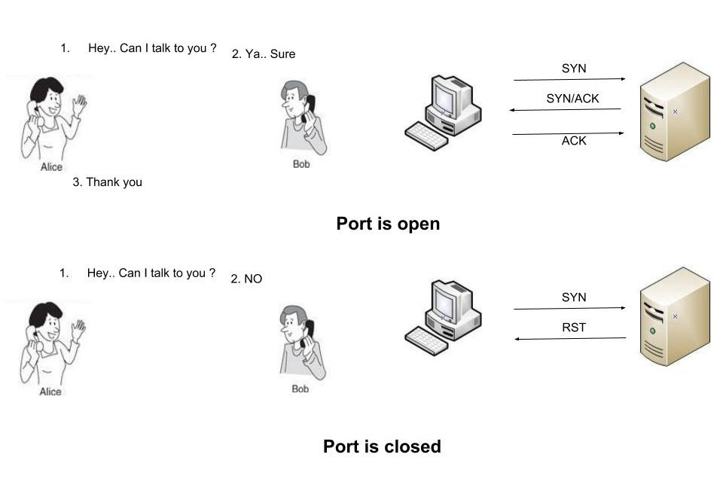
Syntax :-
nmap -p port_number or service_name target_IP_range
nmap -sT port_number target_IP_range

Slide 19
UDP Scan
This method is used to list all open UDP ports on a host.With the help of this scan penetration testers know that they often expose host essential information or can even be vulnerable moreover used to compromise a host.
Syntax:- nmap -sU target_IP

Slide 20
XMAS SCAN
This scan is accomplished by sending packets with the FIN, URG and PUSH flags, if the server sends RST’s regardless of the port state, then that is not vulnerable to this type of scan. If the client didn’t get any response, then the port is considered as open.
Xmas Scan is only workable in Linux machines and does not work on the latest version of windows

Slide 21
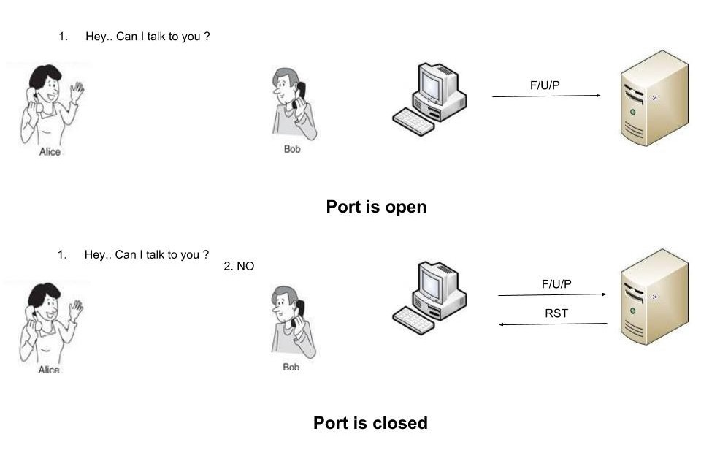
Syntax :- nmap -sX target_IP

Slide 22
NULL Scan
Null scan sends a packet with no flags switched on, if the server sends RST’S regardless of the port state, them that is not vulnerable to this type of scan. If the client didn’t get any response, them the port is considered as open.
Syntax :- nmap -nS target_IP

Slide 23
FIN Scan
A FIN packet is used to terminate the tcp connection between source and destination port typically after the data transfer is complete. In the place of SYN packet, Nmap starts a FIN scan by using a FIN packet. If the port is open then no response will come from destination port when FIN packet is send through source port.
Syntax: - nmap -sF target_IP

Slide 24
OS Detection Scan
Apart from open port enumeration nmap is quite useful in OS fingerprinting. This scan very helpful to penetration tester in order to conclude possible security vulnerabilities and determining the available system calls to set the specific exploit payloads.
Device type
Running
OS CPE
OS details

Slide 25
Cont..
Syntax: nmap -O target_ip
Syntax: nmap -O -p- –osscan-guess <target>
Syntax: nmap -O –osscan-limit <target>

Slide 26
****Complete nmap through practical's****

Slide 27
Dumpster diving
Dumpster diving in the context of network security and forensics refers to the practice of retrieving discarded information from physical or digital trash bins to gain unauthorized access to sensitive data. It is often used by hackers, cybercriminals, or security professionals conducting penetration testing or forensic investigations.
How Dumpster Diving Works
Attackers search for discarded documents, storage devices, or digital files that contain valuable data, such as:
Login credentials (usernames, passwords)
Network configurations (IP addresses, firewall settings)
Personal Identifiable Information (PII) (names, addresses, phone numbers)
Financial records (credit card info, banking details)
Source code or intellectual property
Types of Dumpster Diving
Physical Dumpster Diving – Searching through physical trash bins for paper records, USB drives, CDs, or printed credentials.
Digital Dumpster Diving – Searching through deleted but recoverable files, system logs, or temporary storage locations in computers, networks, or cloud systems.

Slide 28
How Dumpster Diving Is Used in Forensics
Cybercrime Investigations – Digital forensics teams recover deleted or discarded files to trace criminal activities.
Data Recovery – Investigators attempt to reconstruct shredded or deleted files.
Evidence Collection – Security teams analyze discarded devices or documents to find leads on breaches or fraud.
How to Prevent Dumpster Diving Attacks
Shred documents before disposal
Use secure file deletion methods (e.g., wiping software)
Destroy storage devices (e.g., hard drives, USBs) before discarding
Implement data retention and disposal policies
Educate employees about security best practices

Slide 29
War driving
War driving is the practice of searching for Wi-Fi networks by driving around in a vehicle equipped with a laptop, smartphone, or specialized hardware. Attackers or security researchers use this technique to locate, map, and potentially exploit wireless networks.
Scanning for Networks – Using tools like Kismet, NetStumbler, or Wireshark, attackers scan for Wi-Fi signals.
Logging Network Details – Capturing details such as:
SSID (Wi-Fi network name)
BSSID (MAC address of the access point)
Signal strength (RSSI)
Security protocols (WEP, WPA, WPA2, WPA3)
Exploiting Weak Networks – If a network is unsecured or uses weak encryption (e.g., WEP), an attacker can:
Gain unauthorized access
Capture sensitive data
Deploy further attacks, like man-in-the-middle (MITM)

Slide 30
How to Prevent War Driving Attacks
Use strong encryption (WPA3/WPA2 instead of WEP).
Disable SSID broadcasting (hides your network name).
Enable MAC address filtering (allows only trusted devices).
Use a strong, unique Wi-Fi password.
Monitor and audit network logs for unauthorized connections.

Slide 31
Domain ownership- whois, Regional internet registries, server location
1. WHOIS (Domain & IP Lookup)
WHOIS is a public database that stores ownership details of domain names and IP addresses. It helps in identifying:
Domain owner (company, individual, or registrar)
Contact details (email, phone, address – sometimes hidden for privacy)
Registration and expiration dates
Registrar information (the company that registered the domain)
Name servers (which servers host the domain)
Why is WHOIS Important?
✅ Investigating cyber threats (phishing, spam, fraud) ✅ Tracking domain history and ownership transfers ✅ Identifying malicious websites

Slide 32
Whois?
Whois is a widely used Internet record listing that identifies who owns a domain and how to get in contact with them. The Internet Corporation for Assigned Names and Numbers (ICANN) regulates domain name registration and ownership.
A Whois record contains all of the contact information associated with the person, group, or company that registers a particular domain name.
Typically, each Whois record will contain information such as the name and contact information of the Registrant (who owns the domain), the name and contact information of the registrar Registrar (the organization or commercial entity that registered the domain name), the registration dates, the name servers, the most recent update, and the expiration date.
Whois records may also provide the administrative and technical contact information (which is often, but not always, the registrant).

Slide 33
Regional Internet Registries (RIRs)
RIRs manage the allocation of IP addresses and Autonomous System Numbers (ASNs) globally.
There are five major RIRs:
How RIRs Are Used in Security?
Finding IP address ownership to track cyber threats Identifying suspicious traffic sources Blocking malicious IP ranges
RIR | Region Covered | Website
ARIN | North America | www.arin.net
RIPE NCC | Europe, Middle East, Central Asia | www.ripe.net
APNIC | Asia-Pacific | www.apnic.net
LACNIC | Latin America, Caribbean | www.lacnic.net
AFRINIC | Africa | www.afrinic.net

Slide 34
3. Server Location (Geolocation of IPs & Domains)
Determining a server’s location helps in identifying:
Where a website is hosted
The country or region of an IP address
Possible jurisdiction for legal or cybersecurity actions
How to Find a Server's Location?
IP Geolocation Services:
IPinfo.io
MaxMind GeoIP
iplocation.net
Command Line Tools:
traceroute <domain> (Linux/macOS) or tracert <domain> (Windows)
ping <domain>
nslookup <domain>

Slide 35
Routing devices enumeration and countermeasures.
A. SNMP Enumeration (Simple Network Management Protocol)
Attackers exploit SNMP misconfigurations to gather:
Router models and versions
Network interfaces and configurations
Routing tables and ARP caches
Tools Used: Snmpwalk, SNMPCheck, SolarWinds SNMP Scanner
B. Banner Grabbing & Fingerprinting
Attackers use banner grabbing to extract device details from open ports (Telnet, SSH, HTTP, etc.)
Tools Used:
Netcat (nc)
Nmap –sV
Telnet / Curl commands

Slide 36
C. Network Scanning & Traceroute
Identifies active routing devices using network mapping tools
Tools Used:
Nmap (nmap -sn <network> to detect active hosts)
traceroute / tracert (identifies hops in the network path)
D. BGP Enumeration (Border Gateway Protocol)
Attackers query BGP tables to learn about AS (Autonomous Systems), IP prefixes, and routing policies
Tools Used:
bgp.he.net (Hurricane Electric’s BGP Toolkit)
bgpview.io

Slide 37
Countermeasures Against Routing Device Enumeration
A. Secure SNMP Configurations
✅ Disable SNMP if not needed ✅ Use SNMPv3 (encrypted and authenticated) ✅ Restrict SNMP access using ACLs (Access Control Lists) ✅ Change default community strings (e.g., "public" and "private")
B. Harden Network Services (SSH, Telnet, HTTP/HTTPS)
✅ Disable Telnet (use SSH instead) ✅ Use strong authentication (public key authentication for SSH) ✅ Restrict remote management to internal IPs
C. Firewall & ACL Protections
✅ Block ICMP (ping/traceroute) from external sources ✅ Use ACLs to limit router access to trusted networks
D. Router & Firmware Security
✅ Keep firmware updated (patch known vulnerabilities) ✅ Use strong passwords for router access ✅ Enable logging and monitoring for suspicious activity
E. Secure BGP & Routing Protocols
✅ Use BGP route filtering (RPKI, prefix lists, AS path filters) ✅ Enable authentication for dynamic routing protocols (OSPF, BGP, EIGRP)

Slide 38
1. Password Cracking
What is Password Cracking?
Password cracking is the process of recovering plaintext passwords from hashed or encrypted credentials. Attackers or penetration testers use different techniques, such as brute-force, dictionary attacks, and rainbow tables.
Techniques Used
Brute-Force Attack – Tries every possible password combination.
Dictionary Attack – Uses a predefined list of common passwords.
Rainbow Table Attack – Uses precomputed hash values to reverse engineer passwords.
Tools Used
John the Ripper – john --wordlist=<file> hashfile.txt
Hashcat – hashcat -m 0 hashfile.txt wordlist.txt
Hydra – hydra -L users.txt -P passwords.txt <service>://<IP>
How to Perform in VirtualBox?
Install Kali Linux or Parrot OS inside VirtualBox.
Obtain a password hash file from /etc/shadow (Linux) or SAM file (Windows).
Use John the Ripper or Hashcat to crack hashes.

Slide 39
2. Sniffing (Packet Capture & Analysis)
What is Sniffing?
Sniffing is the process of capturing and analyzing network traffic to extract sensitive data, including passwords, login credentials, and network packets.
Techniques Used
Passive Sniffing – Monitoring traffic without interfering.
Active Sniffing – Injecting malicious packets (MITM attack).
Tools Used
Wireshark – GUI-based network packet analyzer.
Tcpdump – Command-line network sniffer.
Ettercap – Performs MITM attacks.
How to Perform in VirtualBox?
Set up two virtual machines (one as a victim, one as an attacker).
Use Wireshark to capture traffic on a shared network adapter.
Filter packets using http.request.method == "POST" to find credentials.

Slide 40
3. Password Hashes and Extraction
What Are Password Hashes?
A password hash is an encrypted version of a password, often stored in system files like /etc/shadow (Linux) or SAM (Windows).
How to Extract Password Hashes?
Linux: cat /etc/shadow (root access required)
Windows: samdump2 SYSTEM SAM > hashes.txt
Mimikatz (Windows) – Extracts passwords in plaintext from memory.
How to Perform in VirtualBox?
Run a Windows VM with a vulnerable setup.
Use Mimikatz or samdump2 to extract hashes.
Crack hashes with Hashcat.

Slide 41
Application Assessment Tools
Popular Application Assessment Tools
These tools focus on web and software applications, checking for vulnerabilities like SQL injection, XSS, authentication flaws, and misconfigurations.
✅ Use Case: These tools help security teams test web applications for vulnerabilities before attackers can exploit them.
Tool | Purpose | Command Example
Burp Suite | Web application security testing (intercepts requests, scans for flaws) | GUI-based
OWASP ZAP | Automated web vulnerability scanner | zap.sh -quickurl http://target.com
Nikto | Web server vulnerability scanner | nikto -h http://target.com
Wapiti | Web application scanner (detects SQLi, XSS) | wapiti -u http://target.com
SQLmap | Automated SQL Injection tool | sqlmap -u "http://target.com?id=1" --dbs

Slide 42
System Assessment Tools
Popular System Assessment Tools
These tools scan operating systems, networks, and devices for weaknesses like open ports, outdated software, weak configurations, and privilege misuses.
✅ Use Case: These tools are used by system administrators and penetration testers to assess security posture and detect weaknesses before attackers do.
Tool | Purpose | Command Example
Nmap | Network scanner for open ports & services | nmap -sV -A target.com
OpenVAS | Open-source vulnerability scanner | GUI-based
Lynis | Linux security auditing | lynis audit system
Nessus | Commercial vulnerability scanner | GUI-based
Metasploit | Exploitation framework | msfconsole
Chkrootkit | Checks for rootkits in Linux | chkrootkit

Slide 43
Exploit Tools
Popular Exploit Tools
Once vulnerabilities are identified, exploit tools allow ethical hackers to test and demonstrate the impact of security flaws.
✅ Use Case: Exploitation tools are used ethically to test security defenses and verify the impact of discovered vulnerabilities.
Tool | Purpose | Command Example
Metasploit Framework | Launches exploits, payloads, and post-exploitation | msfconsole
ExploitDB | Public database of exploits | searchsploit apache
BeEF (Browser Exploitation Framework) | Exploits browser vulnerabilities | GUI-based
Mimikatz | Extracts Windows credentials | mimikatz.exe "privilege::debug" "sekurlsa::logonpasswords" exit
Empire | Post-exploitation tool (PowerShell-based) | ./empire
Responder | Captures network authentication credentials | python Responder.py -I eth0

